Slide 1
Service computing
Main concepts and importance

Slide 2
Service computing main concepts
Service
Service computing
Service oriented architecture

Slide 3
Service
Services represent a type of relationships-based interactions (activities) between at least one service provider and one service consumer to achieve a certain business goal or solution objective.

Slide 4
What is Service Computing?
Services Computing is a cross-discipline that covers the science and technology of bridging the gap between business services and IT services.
Supports integrating the business as linked, repeatable business tasks, or services.

Slide 5
Consider this example
You are a software developer for a large manufacturing company that has their factories, warehouses and clients located in diverse locations across China
You work in the IT department of this company and your job is to develop apps for other departments based on their business needs
Let’s see some examples of the tasks you may need to accomplish

Slide 6
Task 1 – develop an app for the drivers
Drivers need to deliver the products from the warehouses to the customers
The app needs to have some of the functions below
Display the addresses of the customers and their purchase orders
Display the addresses and inventory level of the warehouses
Display the daily tasks - the list of the customers to be visited on a given day
Give the driver the best routes for delivery

Slide 7
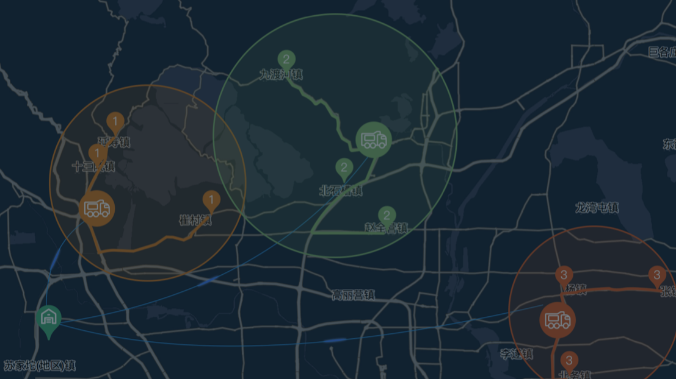
Task 1 – develop an app for the drivers
What modules do you need to develop for this app?
Customer database
Purchase order database
Warehouse database
UI to display daily task
Map interface to display the delivery route
…
…
Sales App
Map functions
Module 1
Module 2
Module 3
Module 4
Module 5
Module 6
Module 7
…

Slide 8
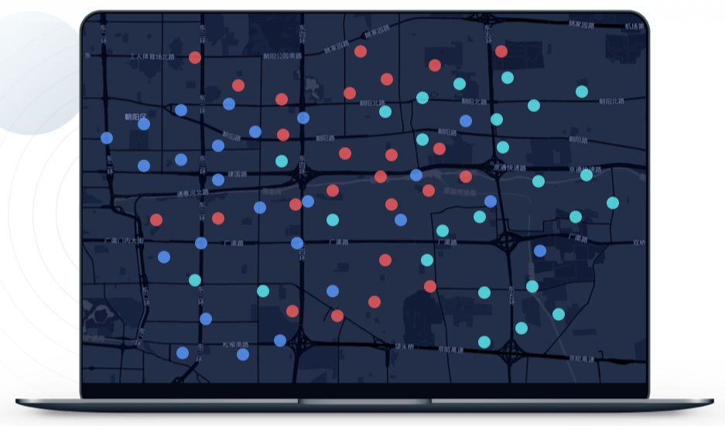
Task 2 – develop an app for the warehouse employees
The warehouses employees need an inventory control system – some of the functions they would like to have
Visualize amount of product available in each warehouse
Visualise production capacity of each factory
Driver App
Map functions
Module 1
Module 2
Module 3
Module 4
Module 5
Module 6
Module 7
…

Slide 9
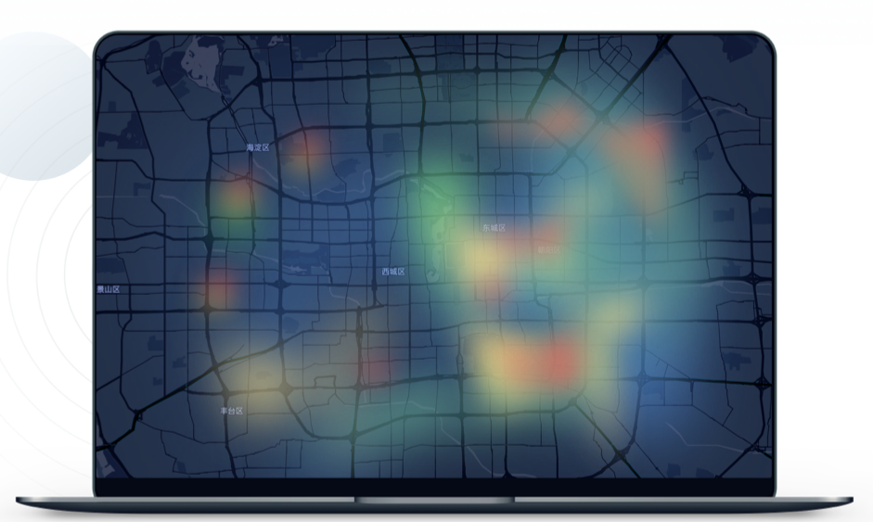
Task 3 – develop an app for the sales team
The sales team needs to track the sales, they would like to be able to generate diverse reports such as
Which customers bought the most/least products in a given period of time
Which product’s sales were the highest/lowest in a given period of time
Which city in China were the largest/smallest market for this product
Sales App
Map functions
Module 1
Module 2
Module 3
Module 4
Module 5
Module 6
Module 7
…

Slide 10
Driver App
Map functions
Module 1
Module 2
Module 3
Module 4
Module 5
Module 6
Module 7
…
How to make your development work more efficient?
Warehouse App
Map functions
Module 1
Module 2
Module 3
Module 4
Module 5
Module 6
Module 7
…
Sales App
Map functions
Module 1
Module 2
Module 3
Module 4
Module 5
Module 6
Module 7
…

Slide 11
How to make your development work more efficient?
You noticed that in all of the tasks you were working on previous year, there was a need to develop some kind of map functions

Slide 12
Abstracting commonly used functions
Can you abstract these map functions and reuse them in all of the apps that need it?
Develop map component as a standalone function and add an interface (API) that can interact with your other APPs.
One of the ways to achieve that is to build your own Web Service

Slide 13
Driver App
Map functions
Module 1
Module 2
Module 3
Module 4
Module 5
Module 6
Module 7
…
Warehouse App
Map Web Service
Map functions
Module 1
Module 2
API
Map functions
Module 3
Module 4
Module 5
Module 6
Module 7
…
Sales App
Map functions
Module 1
Module 2
Module 3
Module 4
Module 5
Module 6
Module 7
…

Slide 14
Driver App
Service consumer
Module 1
Map functions
Module 2
Module 3
Module 4
Module 5
Module 6
Module 7
…
Warehouse App
Map Service Provider
Service consumer
Module 1
Map functions
Module 2
Interface
Map functions
Module 3
Module 4
Module 5
Module 6
Module 7
…
Sales App
Communication language
Service consumer
Module 1
Map functions
Module 2
Module 3
Module 4
Module 5
Module 6
Module 7
…

Slide 15
Towards service orientation
In our example, we have changed the design of our software
We identified one of the software components “Map functions”
We made this software component reusable using service interfaces that use a common communication language over a network

Slide 16
Service (definition 1)
Services represent a type of relationships-based interactions (activities) between at least one service provider and one service consumer to achieve a certain business goal or solution objective.

Slide 17
Driver App
Service consumer
Module 1
Map functions
Module 2
Module 3
Module 4
Module 5
Module 6
Module 7
…
Warehouse App
Map Service Provider
Service consumer
Module 1
Map functions
Module 2
Interface
Map functions
Module 3
Module 4
Module 5
Module 6
Module 7
…
Sales App
Communication language
Service consumer
Module 1
Map functions
Module 2
Module 3
Module 4
Module 5
Module 6
Module 7
…

Slide 18
Service Provider
Service consumer
Communication language
Interface
Functions

Slide 19
Service (definition 1)
Services represent a type of relationships-based interactions (activities) between at least one service provider and one service consumer to achieve a certain business goal or solution objective.
Service Provider
Service consumer
Communication language
Interface
Functions

Slide 20
Service (definition 2)
A service is a self-contained unit of software functionality, or set of functionalities, designed to complete a specific task such as retrieving specified information or executing an operation.
Service Provider
Service consumer
Communication language
Interface
Functions

Slide 21
Service (definition 2-cont.)
It contains the code and data integrations necessary to carry out a complete, discrete business function and can be accessed remotely and interacted with or updated independently
Service Provider
Service consumer
Communication language
Interface
Functions

Slide 22
Service oriented architecture
Service-oriented architecture (SOA) is a type of software design that makes software components reusable using service interfaces that use a common communication language over a network.

Slide 23
Service oriented architecture
SOA integrates software components that have been separately deployed and maintained and allows them to communicate and work together to form software applications across different systems.

Slide 24
Driver App
Service consumer
Module 1
Map functions
Module 2
Module 3
Module 4
Module 5
Module 6
Module 7
…
Warehouse App
Map Service Provider
Service consumer
Module 1
Map functions
Module 2
Interface
Map functions
Module 3
Module 4
Module 5
Module 6
Module 7
…
Sales App
Communication language
Service consumer
Module 1
Map functions
Module 2
Module 3
Module 4
Module 5
Module 6
Module 7
…

Slide 25
Let’s come back to our example - App 1
The drivers mentioned that they would also like to see the traffic information and choose the best route based on that
Do you have access to traffic reports that you can use in your app?
Is there any existing map that you can use instead of building your own Map Web Service?

Slide 26
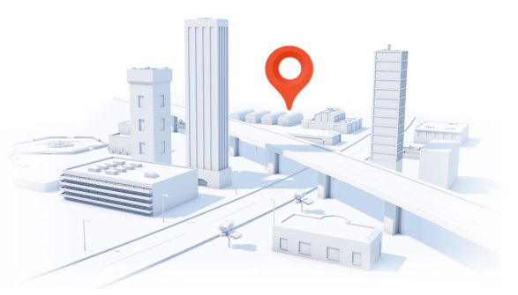
Let’s come back to our example - App 1
The drivers mentioned that they would also like to see the traffic information and choose the best route based on that
Do you have access to traffic reports that you can use in your app?
Is there any existing map that you can use instead of building your own Map Web Service?
You can use the Baidu Map services – initiate request to their Web Service using provided API
https://lbsyun.baidu.com/

Slide 27
Baidu Map as a service - cases
https://api.map.baidu.com/lbsapi/cloud/case.htm
Have a look at some real examples if you are interested

Slide 28
Service oriented architecture
Service-oriented architecture (SOA) is a type of software design that makes software components reusable using service interfaces that use a common communication language over a network.
SOA integrates software components that have been separately deployed and maintained and allows them to communicate and work together to form software applications across different systems.

Slide 29
How you can build applications with service orientation
You can develop your own services and use them as part of your applications
You do not need develop your own services – you can use existing services, developed and maintained by other organizations
…
You can make a service a part of your application
You can build your application by composing several existing services
…

Slide 30
What is Service Computing?
Services Computing is a cross-discipline that covers the science and technology of bridging the gap between business services and IT services.
Supports integrating the business as linked, repeatable business tasks, or services.

Slide 31
Service computing importance
Why it all started – a bit of history, background of service orientation
Importance to the community now – current benefits of service orientation
Importance to you – why should you learn about it

Slide 32
A bit of history
Background of service orientation

Slide 33
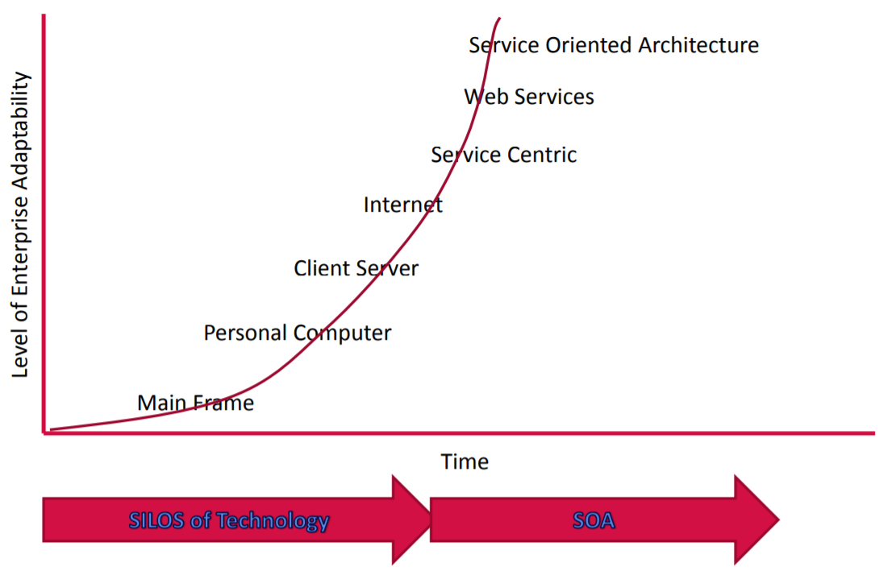
Towards Service Computing in an Enterprise

Slide 34
Towards Service Computing in an Enterprise

Slide 35
How programs were written in 60s?

Slide 36
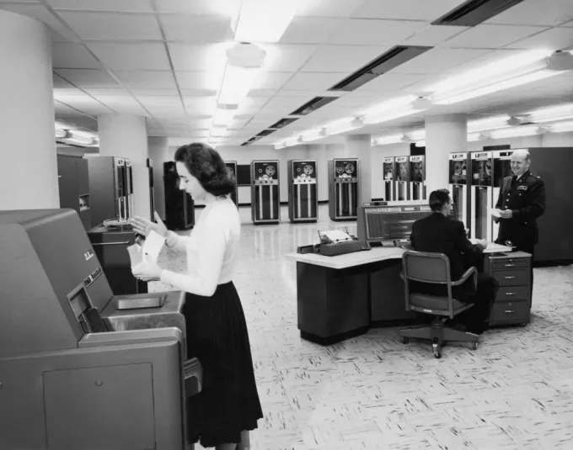
Main Frame
A typical corporate or computer installation had
a suite of rooms, with a large, access-restricted, air-conditioned room for the computer
a smaller quieter room for submitting jobs

Slide 37
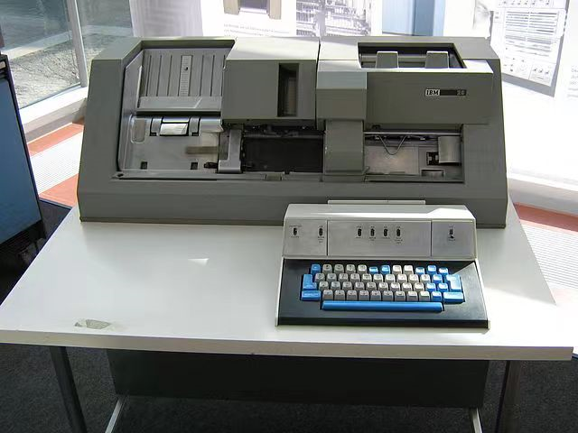
Main Frame
Nearby was a room full of keypunch machines for programmer use

Slide 38
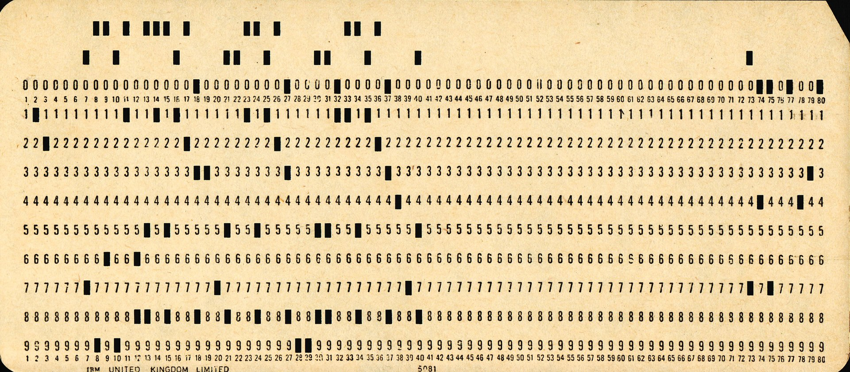
Main Frame
At that time, most computer programmers created, edited and stored their programs line by line on punch cards
a flexible write-once medium that encodes data

Slide 39
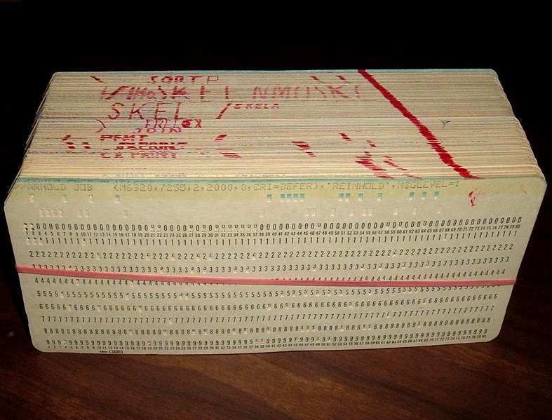
Main Frame
Groups or "decks" of cards form programs and collections of data

Slide 40
Main Frame
Programmers submitted the program decks, to be read by the program, to a person working behind a counter in the computer room

Slide 41
Main Frame
It could take hours or days between submitting a job to the computing center and receiving the output

Slide 42
Main Frame - disadvantages
Computer
Large
Too expensive too be owned by a single person
Operated by a highly skilled personnel

Slide 43
Towards Service Computing in an Enterprise

Slide 44
Personal Computer
Relatively small
Can be afforded by individuals
No high level skills needed to operate it

Slide 45
What are the problems with PC?
PC
code
database

Slide 46
What if you need to make some changes to the database on multiple PCs?

Slide 47
What if you need to make some changes to the database? – maintenance problem

Slide 48
What if your program cannot run on limited hardware?

Slide 49
What if your program cannot run on limited hardware? – performance problem

Slide 50
Personal Computer
Relatively small
Can be afforded by individuals
No high level skills needed to operate it
Program code is deployed, executed and maintained on the same machine – many challenges - maintenance, performance, …

Slide 51
Towards Service Computing in an Enterprise

Slide 52
What if you need to make some changes to the database? – maintenance problem

Slide 53
Solution – client-server model
Client
Client
Server
Client
Data
base
Client
Client
Client
Client
Client

Slide 54
Client server
A distributed application structure that partitions tasks or workloads between providers of the resource and requestors
Program is split into two parts
Server – a provider of some function
Client – requestor of the function
Client and server can be deployed on different machines
Many clients can connect to one server

Slide 55
Client server
A distributed application structure that partitions tasks or workloads between providers of the resource and requestors
Program is split into two parts
Server – a provider of some function
Client – requestor of the function
Client and server can be deployed on different machines
Many clients can connect to one server

Slide 56
Towards Service Computing in an Enterprise
Internet enabled server and client part of the program deployed on machines distributed across different networks
More exciting applications became possible, not only in the enterprise domain

Slide 57
Towards Service Computing in an Enterprise
But at the same time, the Internet exposed the limitations of client-server model in large scale dynamic environments, such as
Scalability issues
Mobility issues
…

Slide 58
Client-server vs service orientation
The traditional client-server model often lacks well-defined public contracts that are independent of the client or server implementation
this means a client is tied to a particular server
In Service Computing
components publish and use services in a peer-to-peer manner
a client is not tied to a particular server
service providers are interchangeable

Slide 59
Client-server vs service orientation
Traditional client-server – more coupled
The server exists for a specific client, without planning for re-use
In service orientation – decoupling
the server side is very independent of the client
Many different client types use the same server
In this way SOA services are designed for reuse
Coupling = 耦合性

Slide 60
Towards Service Computing in an Enterprise

Slide 61
Object orientation vs service orientation
Object oriented programming is built on the premise that programming problems can be modelled in terms of the objects in the problem domain
focuses on what things are and how they are constructed
Service oriented programming adds the premise that problems can be modelled in terms of the services that an object provides or uses
focuses on what things can do

Slide 62
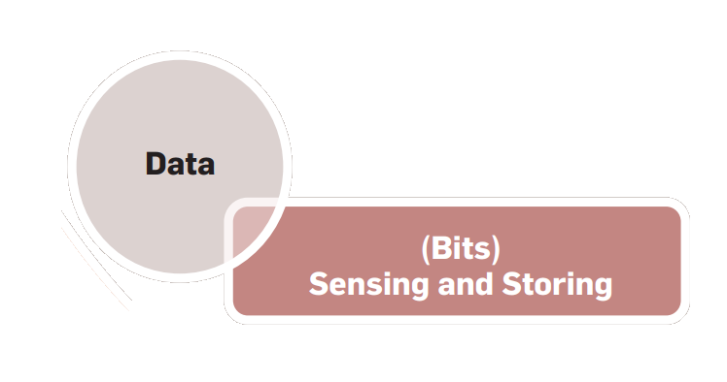
Some more history – evolution of challenges in IT
In the early days of computing, the challenge was to represent information in a machine-readable format that consisted of bits and bytes, called data

Slide 63
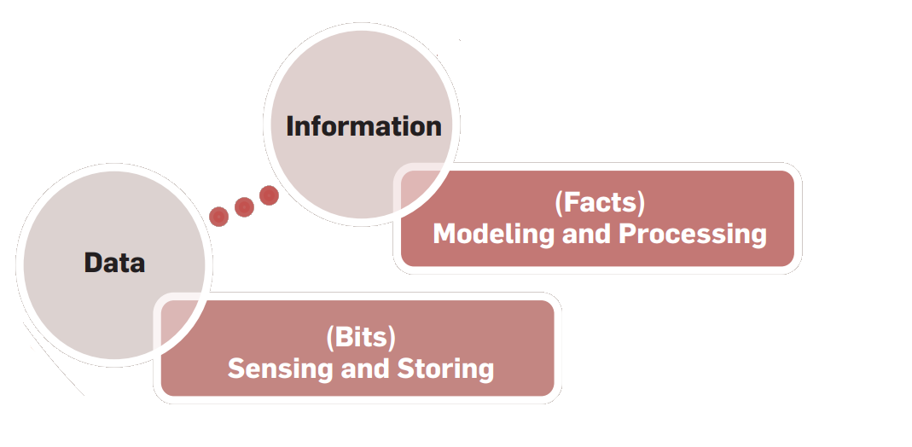
Some more history – evolution of challenges in IT
Over time, there was keen interest in complementing data with meaning, thus transforming it to information

Slide 64
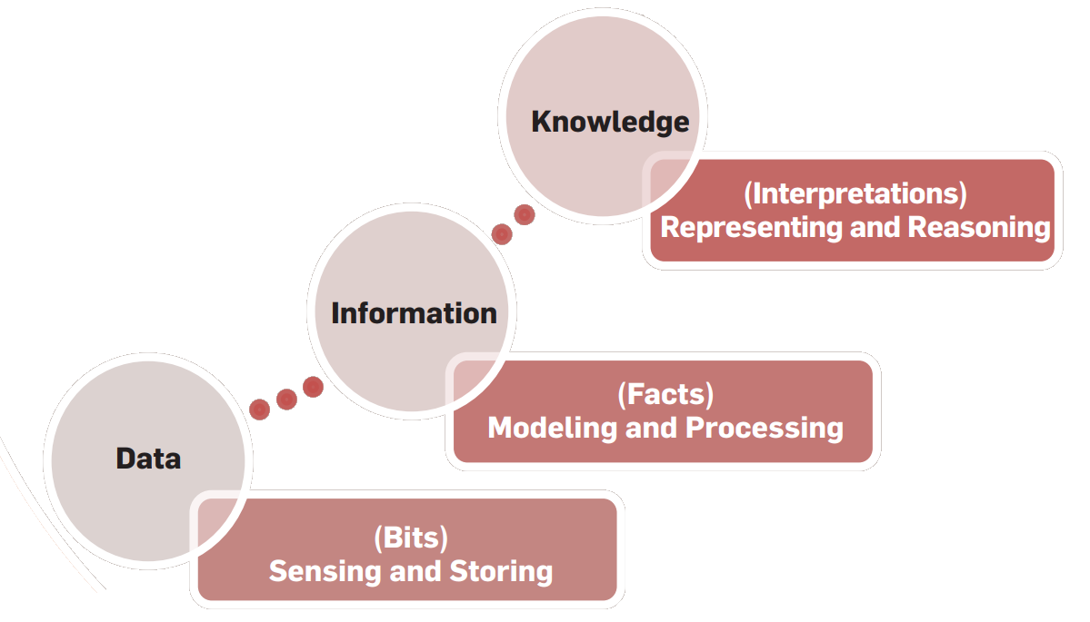
Some more history – evolution of challenges in IT
With further advances in computing came the idea of adding reasoning to information, thus giving rise to knowledge

Slide 65
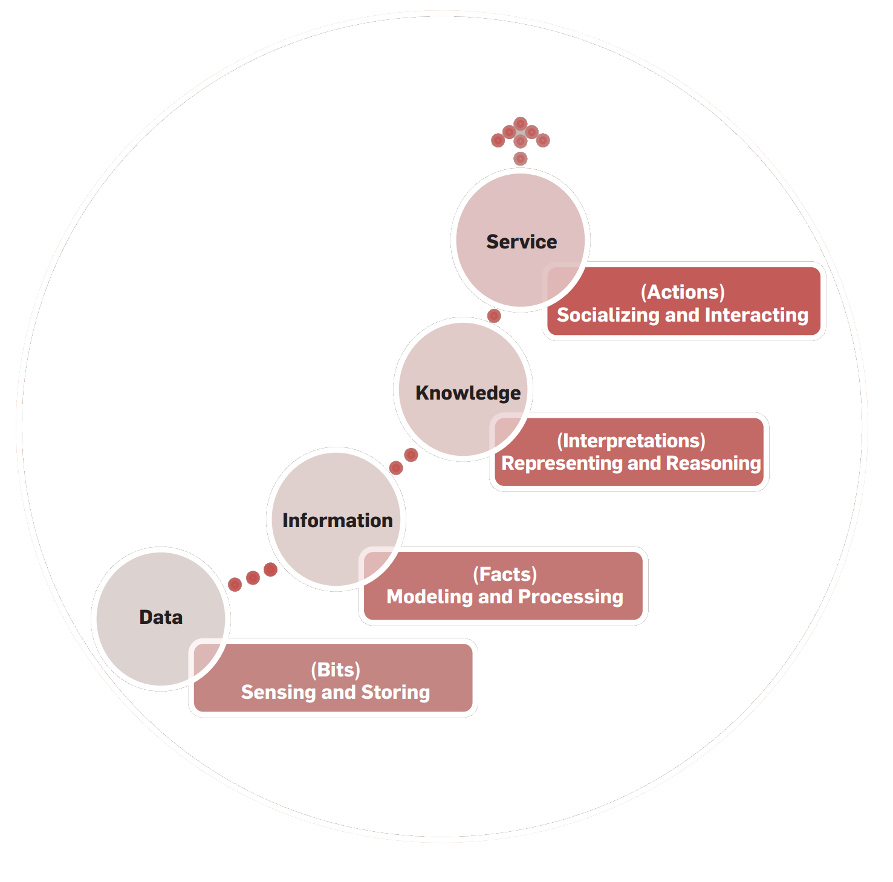
Some more history – evolution of challenges in IT
The need for higher levels of abstraction has recently led to the notion of adding action to knowledge, providing a way for knowledge to be useful, resulting in services

Slide 66
Trends in IT – towards service computing

Slide 67
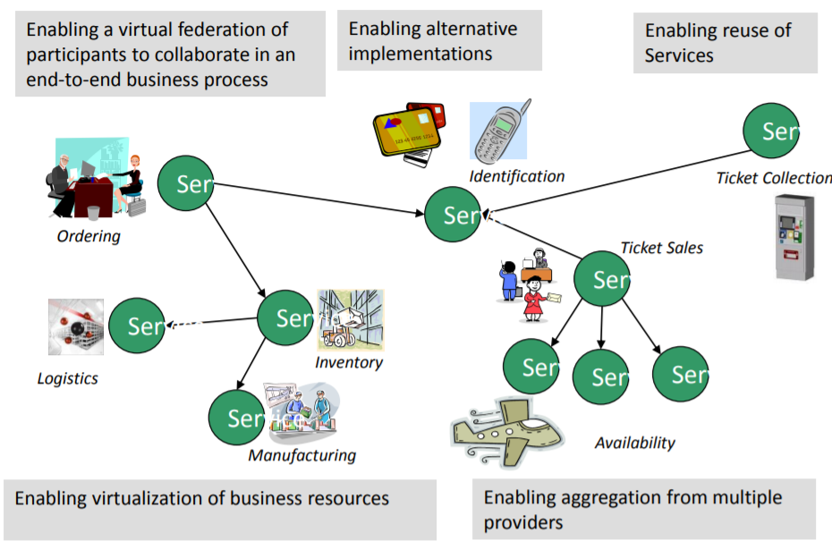
Motivation - ENABLE FLEXIBLE, FEDERATED BUSINESS PROCESSES
Enable flexible, federated business processes

Slide 68
Service orientation in an Enterprise
Enterprises (bank, aviation, restaurant )are made up of a set of Business Processes
manufacture products
buy and/or sell
receive money
issue invoices
pay staff
…
Most of these processes can be broken down into more fundamental discrete building blocks known as services.

Slide 69
The goal of Service Computing
Enable IT services and computing technology to perform business services more efficiently and effectively.
How to divide distributed systems to “services” which can be separately invoked through network requests and can provide independent functionalities
How to manage and evaluate existing services
How to reuse these services building more complex, composite services
How to assure quality of services

Slide 70
Activities in a service lifecycle
business componentization
services modelling
services creation
services realization
services annotation
services deployment
services discovery
services composition
services delivery
service-to-service collaboration
services monitoring
services optimization
services management

Slide 71
Importance of Service computing
Benefits for enterprises
Recent applications and underlying technologies

Slide 72
What are the expected benefits of service computing you can think of based on our discussion so far?

Slide 73
Business benefits – decreased cost
Decreased cost:
Add value to core investments by leveraging existing assets
New systems can be built faster for less money
Reducing integration expense
Built for flexibility
Long term value of interoperability

Slide 74
Business benefits – increased productivity
Increased employee productivity:
Built on existing skills
Consolidate duplicate functionality

Slide 75
Business benefits - partnership
Built for partnerships:
Standards based
Business relationships expressed via service interactions
Integration is driven by what is needed, not what is technically possible

Slide 76
Business benefits – agility
Agility - Built for change
Helps applications evolve over time and last
Abstract the backend and replace over time
Focusing on core-competencies
Incremental implementation approach is supported
Service Outsourcing – new business model!

Slide 77
Technical Benefits
Services Scale
Build scalable, evolvable systems
Scale down to mobile devices
Scale up to for large systems or across organizations
Manage complex systems
Does not require centralized services
Empowers users with high end communication
Platform independent use
Loose Coupling allows flexibility

Slide 78
Benefits for developers and users of service oriented systems

Slide 79
Service computing applications
Web applications
Mobile applications
Cloud systems
Big data applications
IoT Systems
Blockchain systems
Workflow systems
Other distributed systems

Slide 80
Underlying technologies
Web services
Service-oriented architecture (SOA)
Cloud computing
Business process modelling
….

Slide 81
How can this course benefit you?

Slide 82
Importance to you
Where/when the service computing knowledge/skills/thinking will be needed?

Slide 83
Summary
Service computing is based on a premise that problems can be modelled in terms of the services
A service is a self-contained unit of software functionality, or set of functionalities, designed to complete a specific task such as retrieving specified information or executing an operation
Services represent a type of relationships-based interactions (activities) between at least one service provider and one service consumer to achieve a certain business goal or solution objective.

